Slide 1

McGraw-Hill Technology Education
Copyright © 2006 by The McGraw-Hill Companies, Inc. All rights reserved.

Slide 2
Chapter 14B
Taking Protective Measures

Slide 3
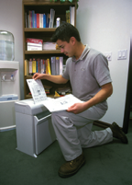
Avoiding Identity Theft
Guard your papers
  Shred unneeded papers
  Pick up you mail quickly
  Check statements immediately
  Keep records for 3 years
Notes:
Teaching tip
Start the lecture reminding students that they should not use pirated software in general. However, using pirated security software is especially dumb. It is equivalent to letting a burglar install the new locks on your house.

Slide 4
Avoiding Identity Theft
Guard your personal information
  Be wary giving out information
  Avoid giving account numbers
  Never give personal information in e-mail
  Ensure online shopping is secure
Notes:
Teaching tip
Secure online shopping is covered in chapter 10.

Slide 5
Avoiding Identity Theft
Look at the big picture
  Review your credit report yearly
  Develop an efficient filing system
  Know your liability limits
Notes:
Teaching tip
The Federal Fair Dept Collections Practices Act allow residents one free credit report a year. Several sites offer pay access to a credit report. Visit www.creditreport.com/report_sample_m.html for a sample report. Visit www.freecreditreport.com for a free report.

Slide 6
Protecting Your Privacy
Keep marketers at bay
  Be wary filling out forms
  Guard your primary email address
    Have a ‘spam account’ for forms

Slide 7
Protecting Your Privacy
Know your legal rights
  1966 Freedom of Information Act
  1970 Fair Credit Reporting Act
  Privacy Act of 1974
  1986 Electronic Communications Act
  Financial Modernization Act of 1999
  2001 USA Patriot Act

Slide 8
Managing Cookies and Spyware
Dealing with cookies
  Browsers provide settings to block cookies
  No cookies to all cookies allowed
  Without cookies some sites crash
  Cookies can be deleted
    Browsers
    Spyware programs

Slide 9
Managing Cookies and Spyware
Cookie types
  Session cookies
    Cookies for the current site
  Persistent cookies
    Stored on hard drive until deleted
  First-party cookies
    Installed by the current site
  Third-party cookies
    Installed by an ad
Notes:
Teaching tip
Third party cookies are a primary source for spyware.

Slide 10
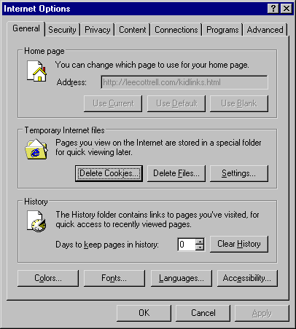
Deleting Cookies

Slide 11
Managing Cookies and Spyware
Removing web bugs and spyware
  Install a spyware removal program
    None are 100% effective, use two
  Install a pop-up blocker
    Are extremely effective
Notes:
Teaching tip
In 2004 PC World ranked Patrick Kolla’s Spybot and LavaSoft’s AdAware as the best spyware programs available. Both are free downloads.
Teaching tip
Google, Msn and Yahoo all offer excellent free popup blockers. Additionally the new Mozilla browser FireFox includes a popup blocker. Finally, Windows XP Service Pack 2 installs a popup blocker.

Slide 12
Managing Cookies and Spyware
Evading spam
  Contact your ISP
  Use mail program’s filters
  Use an anti-spam program
  Use an online account for purchasing
Notes:
Insider information
America Online takes a very aggressive approach about blocking spam. After a certain number of customers mark an email as spam, AOL will refuse to accept email from that sender.
Teaching tip
Mozilla products include spam software. For Outlook and Eudora users, download MailWasher from www.mailwasher.net/.

Slide 13
Protection From Malware
Viruses and worms
  Purchase a good anti-virus product
  Keep the product updated
  Keep your OS up to date
Notes:
Teaching tip
The Computing Keynote feature at the end of chapter 14B provides a thorough examination of virus removal. PC World routinely picks either Norton AntiVirus or McAfee AntiVirus as best buys. A decent free product is AntiVir personal edition available for download at www.mailwasher.net/.

Slide 14
Protecting Your System
Limit physical access
  Easiest way to harm or steal data
  Build an account for each user
  Require a password for access
    Software and hardware password
Notes:
Teaching tip
Remind students that passwords should be easy to remember but hard to guess.

Slide 15
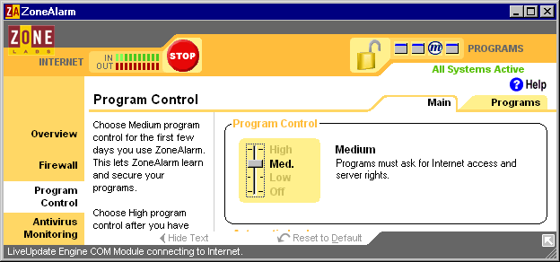
Protecting Your System
Use a firewall
  Protects from unauthorized remote use
  Makes your computer invisible
  Cost between $0 and $80
Notes:
Teaching tip
The built in firewall in XP is not very strong. Many ports remain open. Disable Windows’ Firewall and install a free firewall from Zone Labs instead.

Slide 16
Protecting Your System
Backup often
  Backup is a copy of a file
  Restore replaces a file on disk
  Organizations backup at least daily
  Home users should backup weekly
Notes:
Teaching tip
All versions of Windows since 95 have included a good backup utility. Other products include Norton Ghost and EVault InfoStage.

Slide 17
System Events
OS generates messages for events
Provides clues about computer health
Can alert to potential problems
Windows includes the Event Viewer
Notes:
Teaching tip
Open the event viewer for demonstration in class. A good method to generate an error is to disable the virus software on the system.

Slide 18
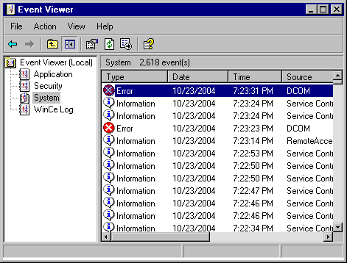
Event Viewer

Slide 19
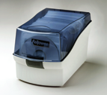
Handling Storage Media
Store media in the proper container
  Floppy disks in a hard case
  CD should be in a sleeve
  Thumb disks should be closed

Slide 20
Handling Storage Media
Avoid magnetism
  Magnets erase the contents of disks
  Magnets found in
    Speakers
    Televisions and CRT monitors
    Radios

Slide 21
Handling Storage Media
Heat and cold
  Avoid extreme temperatures
    Heat expands media
    Cold contracts media
  Floppies and CD-ROMs are susceptible
Notes:
Teaching tip
Suggest to your students that the CD’s they burn and store in their car are likely to have a short life.

Slide 22
Handling Storage Media
Moisture
  Do not use wet media
  CDs can be wiped off
  Floppy disks must dry for days

Slide 23
Handling Storage Media
Dust, dirt, and fingerprints
  Dirty or scratched media will fail
  Handle media by the edge
  Clean CDs with gentle strokes

Slide 24
Storing Computer Equipment
Never store near large electronics
Store in dry, climate controlled rooms
Plan for natural disasters
Stack equipment safely

Slide 25
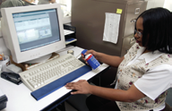
Keeping Your Computer Clean
Computers should be spotless
Avoid eating or smoking at computer
Clean the dust from inside the system
Change the filters if present

Slide 26
Chapter 14B
End of Chapter

